Slide 1


Slide 2

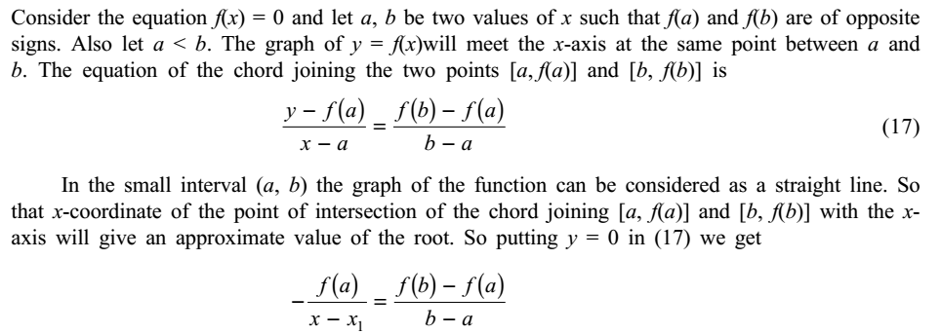

Numerical Methods
National University of Science and Technology, Islamabad

Slide 3
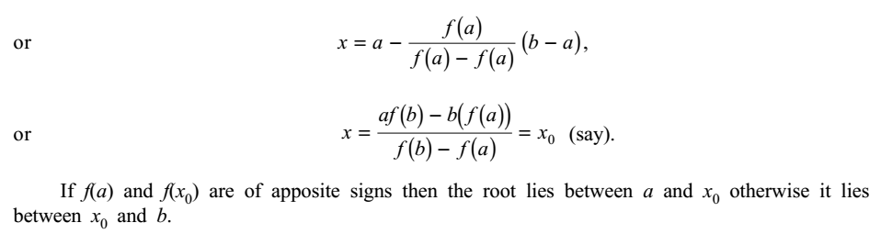
Numerical Methods
National University of Science and Technology, Islamabad

Slide 4
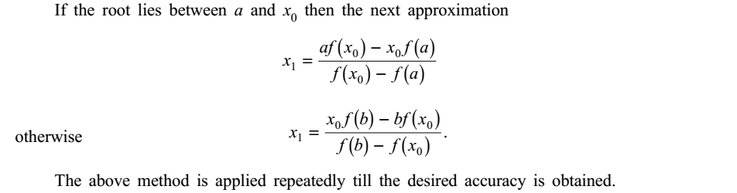
Numerical Methods
National University of Science and Technology, Islamabad

Slide 5
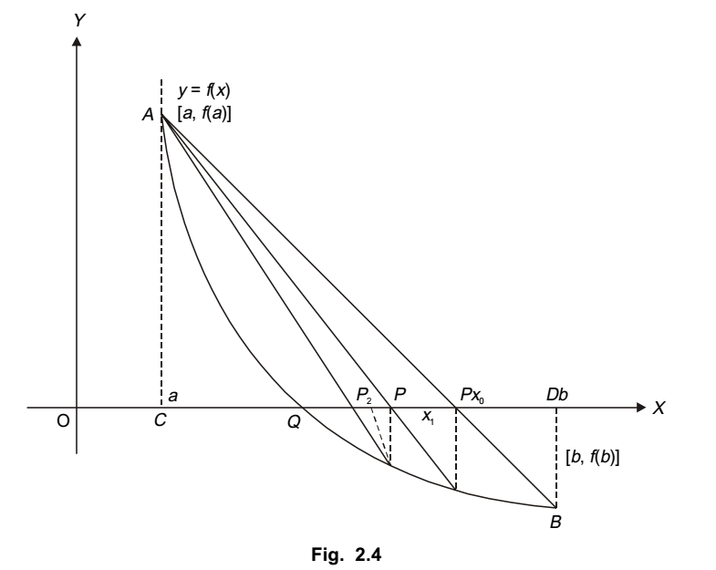
Numerical Methods
National University of Science and Technology, Islamabad

Slide 6
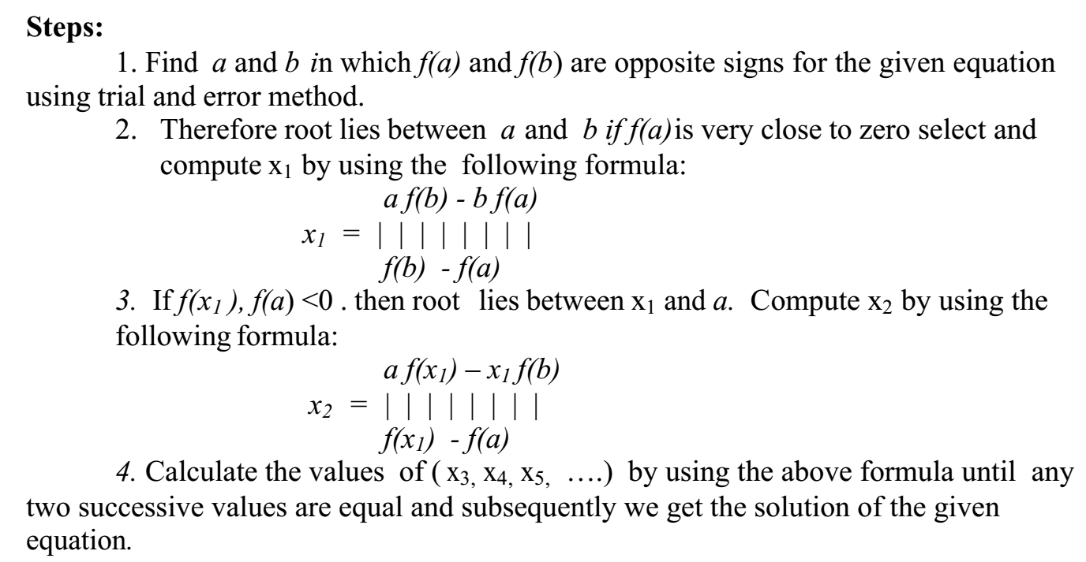


Numerical Methods
Working Steps for Regula-Falsi Method (Algorithm)
National University of Science and Technology, Islamabad

Slide 7
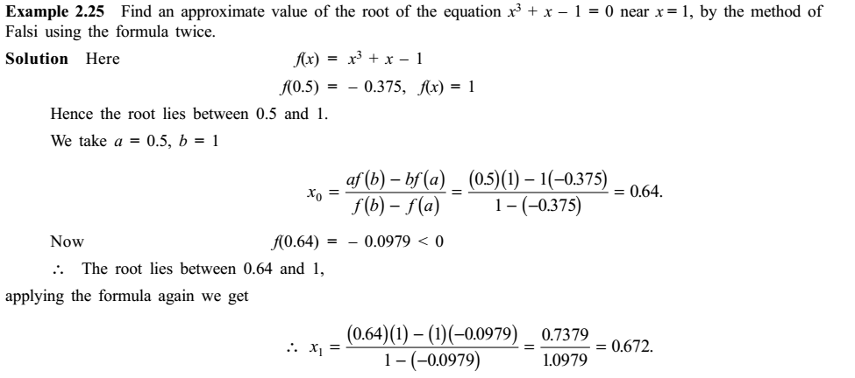
Numerical Methods
National University of Science and Technology, Islamabad

Slide 8
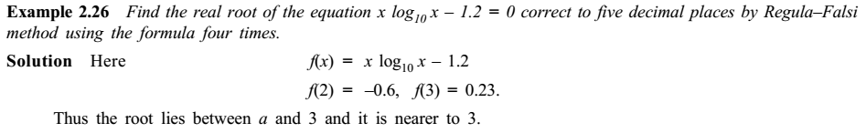
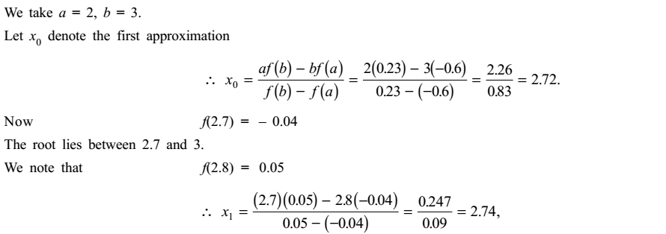
Numerical Methods
National University of Science and Technology, Islamabad

Slide 9
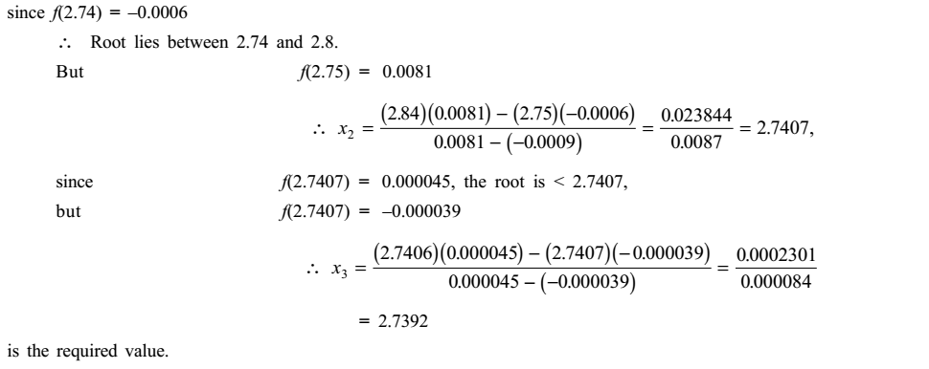
Numerical Methods
National University of Science and Technology, Islamabad

Slide 10
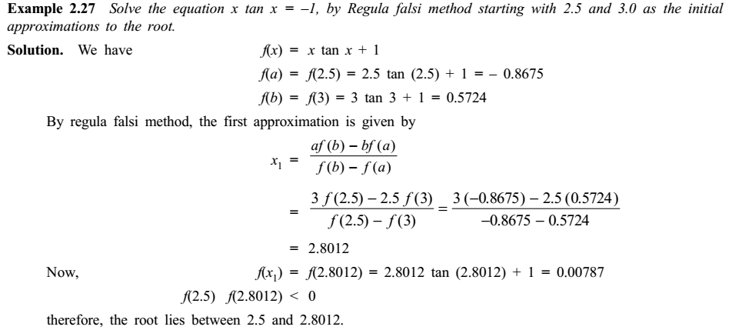
Numerical Methods
National University of Science and Technology, Islamabad

Slide 11
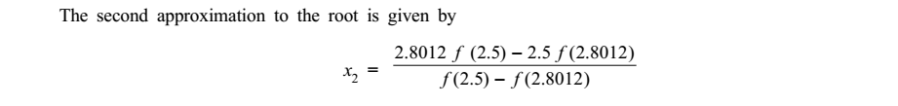
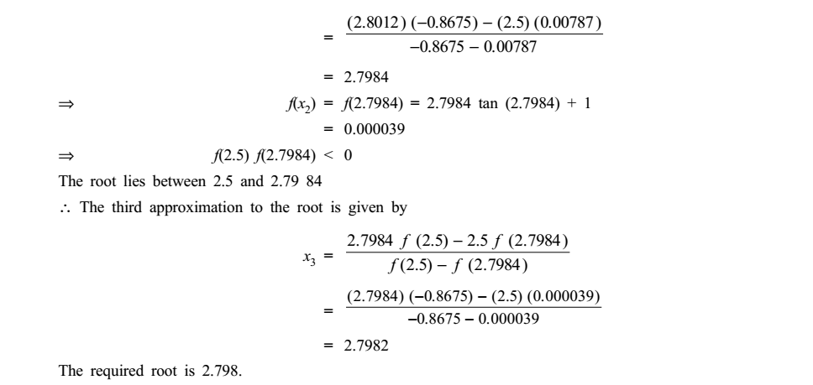
Numerical Methods
National University of Science and Technology, Islamabad

Slide 12
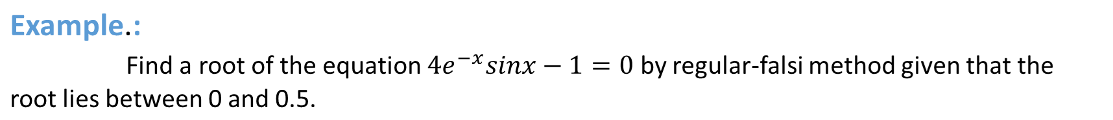
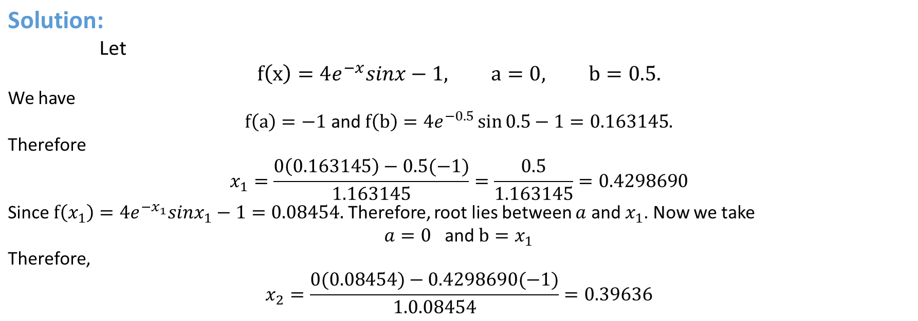
Numerical Methods
National University of Science and Technology, Islamabad

Slide 13
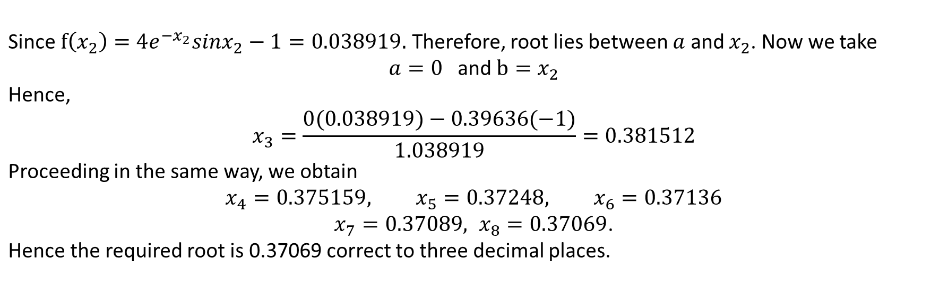
Numerical Methods
National University of Science and Technology, Islamabad

Slide 14

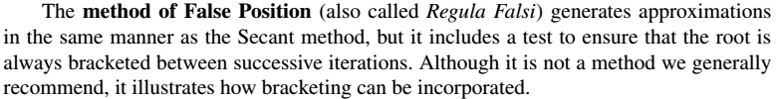
Numerical Methods
National University of Science and Technology, Islamabad

Slide 15


Numerical Methods
Attempt all the examples and practice questions of Regula Falsi method by Secant method
National University of Science and Technology, Islamabad

Slide 16
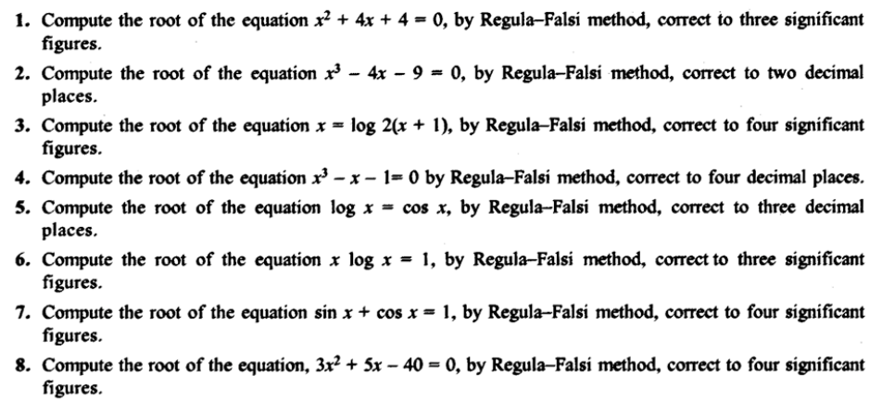
Numerical Methods
Practice Questions on Regula-Falsi Method
National University of Science and Technology, Islamabad

Slide 17
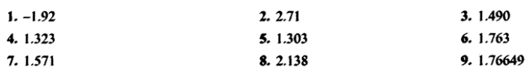

Numerical Methods
Answers to Practice Questions
Quaid-i-Azam University
Department of Mathematics
National University of Science and Technology, Islamabad

